Slide 1


Convolutional Neural Networks and Vision Transformers for Natural and Urban Scene Classification
Subject: Deep Learning
Teacher: Ricardo Abel Espinosa Loera
Degree: MIACD 3
Student: Josue Emmanuel Jauregui Arvilla

Slide 2






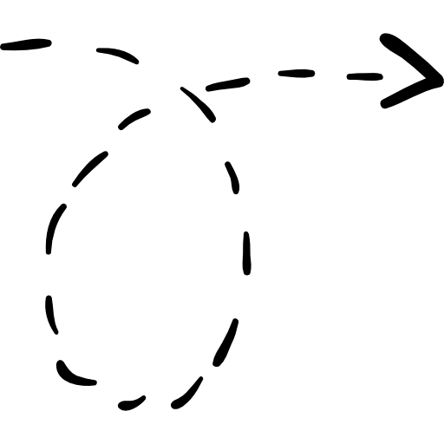




Intel Image Classification
14,034
Training
Buildings
Forest
Glacier
17,034
Images
3,000
Evaluation
Mountain
Sea
Street

Slide 3







HYPERPARAMETERS
MODELS
HARDWARE
ResNet-50
RTX 4090
~25.6M Params | Residual CNN
24GB GDDR6X VRAM
Parameter | Value
Optimizer | AdamW
Learning Rate | 1 × 10⁻⁴
Batch Size | 32
Epochs | 10
EfficientNet B0
Ryzen 9 7950x3D
~5.3M Params | MBConv
16 Cores / 32 Threads
ViT_B_16
64GB DDR5
~86.0M Params | Vision Transformer
@ 6000MHz Dual-Channel

Slide 4

Top Performance
Most Efficient
Resource Intensive
ResNet-50
EfficientNet-B0
Vit-B/16
93.96% F1-Score
4.0M Params
5.16 GB VRAM
Best Overall Accuracy (93.87% Val Acc.)
Moderate Compute (23.5M Params)
Near-ResNet Performance (93.33% Val Acc.)
Fastest Training (22.86 min)
Highest Parameter Count (85.8 M)
Lower Performance (93.00% Val Acc.)
Model | Train Acc. | Val Acc. | F1-Score | Parameters | Time (s) | VRAM (MB)
ResNet-50 | 0.9862 | 0.9387 | 0.9396 | 23,520,326 | 1438.88 | 2958.55
EfficientNet-B0 | 0.9848 | 0.9333 | 0.9345 | 4,015,234 | 1372.45 | 2973.57
ViT-B/16 | 0.9691 | 0.9300 | 0.9312 | 85,803,270 | 1809.19 | 5165.87

Slide 5
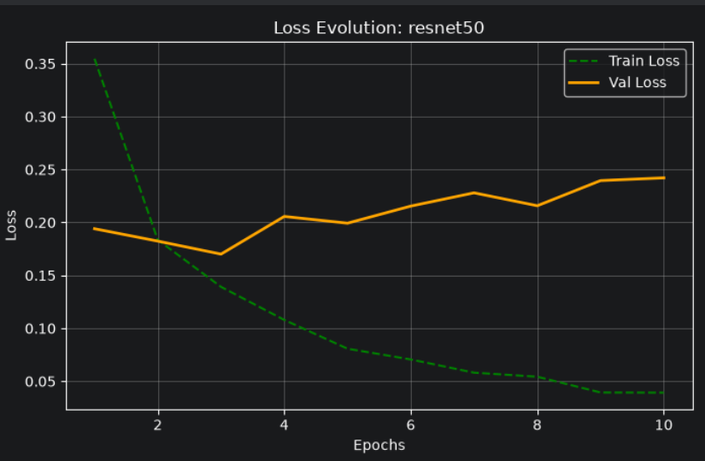
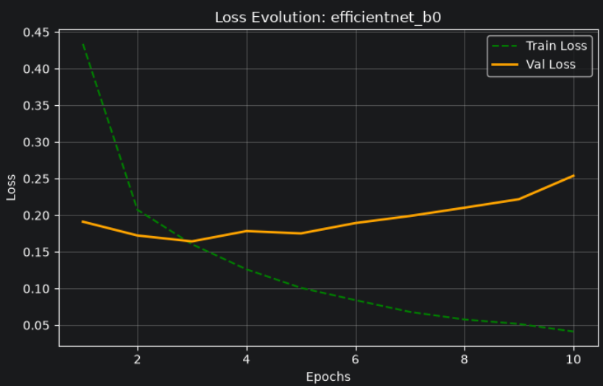
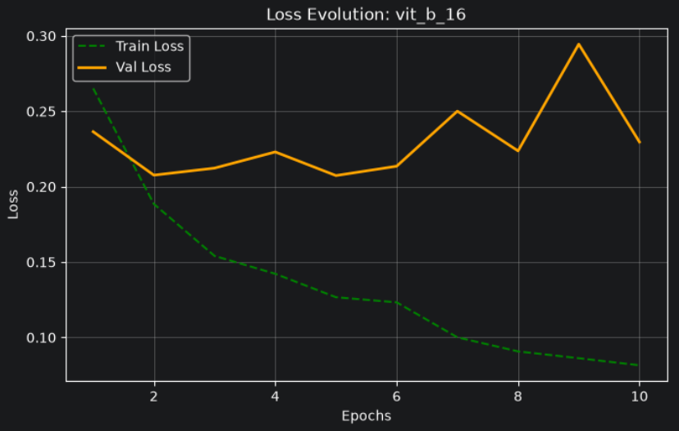
LOSS EVOLUTION & CONVERGENCE ANALYSIS
ResNet-50
EfficientNet-B0
Vit-B/16

Slide 6
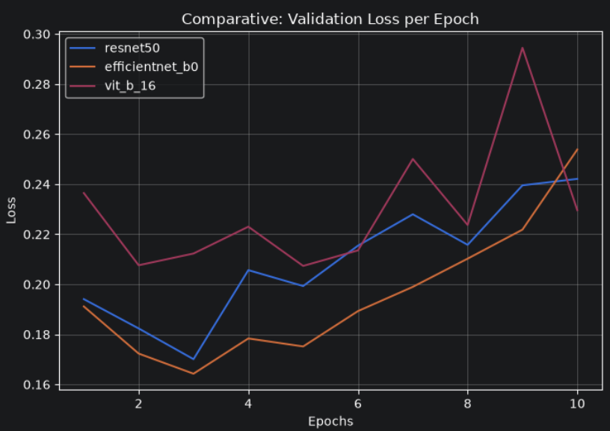
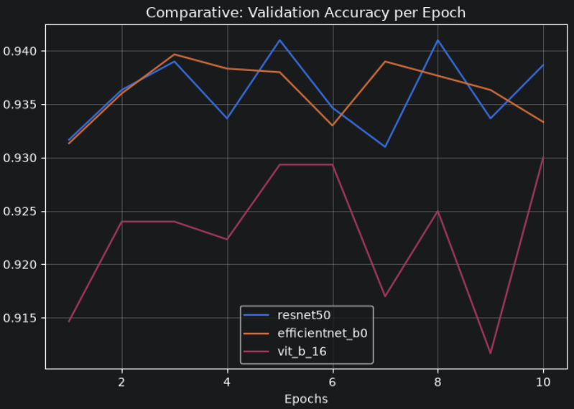
Experimental Results and Model Comparison

Slide 7

Conclusion

